Slide 1
BRL Office Space Request Application
July 2023
Presented by Yuzhu Liu
Business Intelligence Team

Slide 2
Agenda
Project Background
Space Request Process Showcase
Learnings and Takeaways
Q&A

Slide 3

Blue Ridge Labs

Slide 4
Why Moving to Salesforce
Team Collaboration
DATA Consolidation
Process efficiency
Scalability

Slide 5
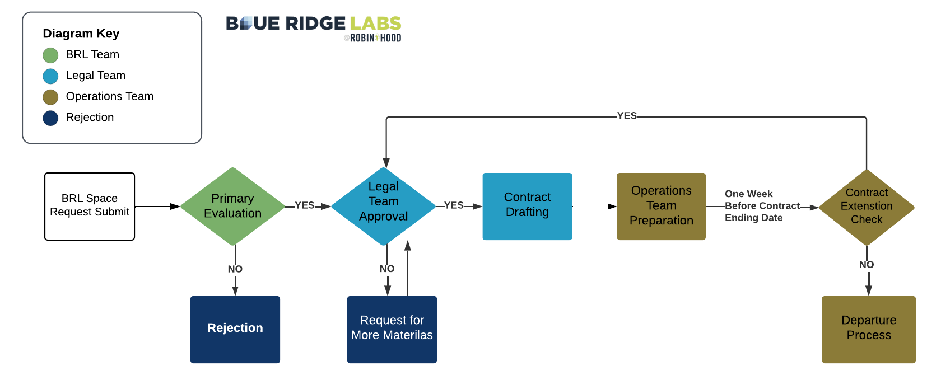
Space Request Process Showcase

Slide 6
Features Highlight
Page
Layout
DATA
analytics
Track
Process
Automatic email alerts

Slide 7
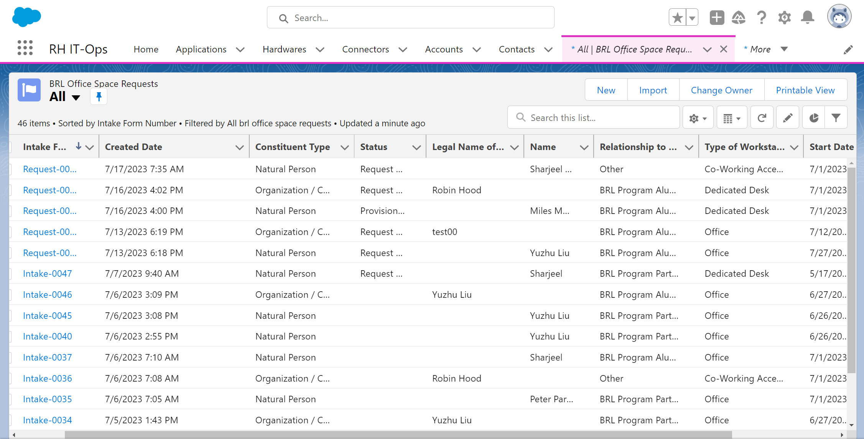
Page Layouts – List View

Slide 8
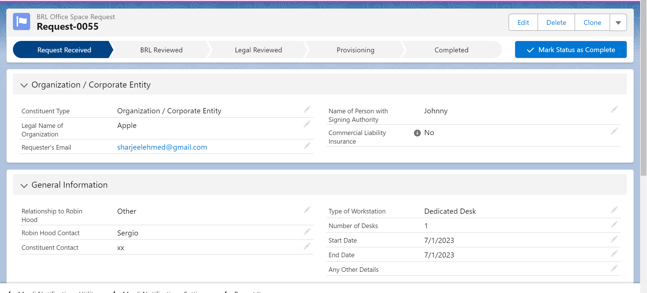
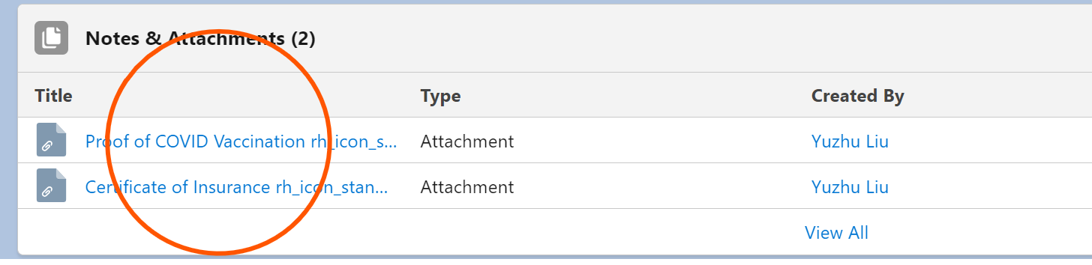
Page Layouts – Record Details

Slide 9
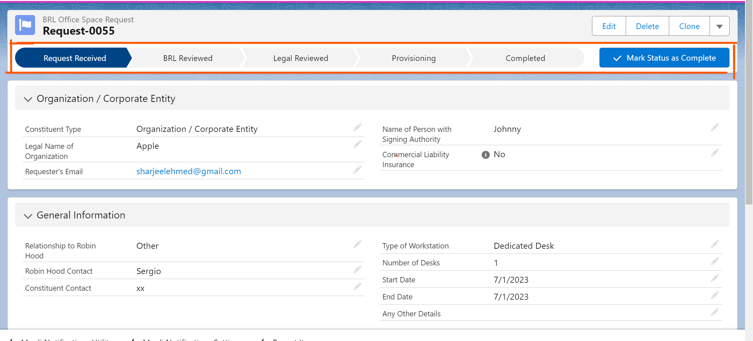
Track Process

Slide 10
Features Highlight
Page
Layout
DATA
analytics
Track
Process
Automatic email alerts

Slide 11



Learnings and Takeaways
BRL Team
Legal Team
Operations Team
Work cross-functionally
Multiple platform integrations
Learning on the go

Slide 12

Next Steps
Finalize the System Build
Testing and Rollout
Data Visualization and Analysis

Slide 13
Q&A

